Slide 1
FY25 PROPOSED DRAFT BUDGET
FEBRUARY 2024
Berkshire Hills Regional School District

Slide 2
Mission
To ensure all students are challenged through a wide range of experiences to become engaged, curious learners and problem solvers who effectively communicate, respect diversity, and improve themselves and their community.

Slide 3
Budget Priorities
Continue to provide high quality education for all students.
Continue to provide a range of social-emotional supports.
Ensure equitable access for all students.

Slide 4
FY25
Proposed Budget

Slide 5
FY 25
BUDGET CHANGES

Slide 6
PERSONNEL
ELEMENTARY SCHOOL
Reallocate existing resources to meet changing enrollment, as needed.
Reduce Kindergarten to three sections.
In-depth Professional Development in Math.

Slide 7
PERSONNEL
MIDDLE SCHOOL
Continued four core teams and specials.
Continued professional development for SEL.
Potential reallocation of 1.0 FTE to ES.

Slide 8
PERSONNEL
HIGH SCHOOL
Continued review and planning for additional CVTE programming and staffing.
Reduce math staffing by .5 FTE.
Reduce Social Studies by 1.0 FTE.
Additional 1.0 FTE reduction.

Slide 9
PERSONNEL
DISTRICTWIDE
Potential elimination of DEIB position.
Potential reallocation of responsibilities to consultants.
Based on School Committee feedback – position elimination and/or reallocation later withdrawn.
Recommended to be funded through grants.

Slide 10
OTHER
Health & Dental Insurance
5.39% total increase for health in FY25 ($301,760).
BHG rates set at 7% set; actual change compensates for changes in enrollment.
No premium holiday approved for FY24.
No change in dental rates.

Slide 11
OTHER
Health & Dental Insurance (cont.)
MEDEX rate changes in January of each year; 5.5% increase for 2024.
Berkshire County Retirement
Actual invoice amount to fully fund system, 4.07% ($41,836).

Slide 12
OTHER
Educational Services & Tuition
Decrease of 2.15% (-$42,500).
Transportation
Increase of 11.04% ($293,826).
Out-of-District Transportation increased.

Slide 13
OTHER
Technology
Increase of 30.45% ($105,500).
Software & refresh of devices.
Facilities & Operations
Slight increase of 1.84% ($12,050).

Slide 14
OTHER
Utilities
Increase of 2.24% ($21,920).
Educ. Supplies, Materials & Equip
Increase of 4.05% ($16,350).
Prof. Development
Decrease of 0.77% (-$1,050).

Slide 15
OTHER
Legal & Other insurances
Decrease of 2.31% (-$3,870)
Other Administrative Costs
Increase of 1.06% ($4,000).

Slide 16
OPERATING BUDGET
FY25
Proposed Budget

Slide 17
Operating Budget
Expenditures Change
$ 35,039,758 gross operating budget
$1,517,900 4.53%

Slide 18
Summary
CATEGORY CATEGORY % of TOTAL $ CHANGE
CHANGE CHANGE
Salaries 4.14% 50.56% $ 767,403
Benefits 4.46% 20.97% $ 318,271
Transportation 11.04% 19.36% $ 293,826

Slide 19
Summary
CATEGORY CATEGORY % of TOTAL $ CHANGE
CHANGE CHANGE
Technology 30.45% 6.95% $ 105,500
Educ. Services 5.62% 5.75% $ 105,000
& Tuition
Educ. Supplies, 4.05% 1.08% $ 16,350
Materials & Equip.

Slide 20
Summary
CATEGORY CATEGORY % of TOTAL $ CHANGE
CHANGE CHANGE
Activities & 13.61% 1.71% $ 26,000
Athletics
Utilities 2.42% 1.44% $ 21,920
Facilities & 1.84% 0.79% $ 12,050
Operations

Slide 21
Summary
CATEGORY CATEGORY % of TOTAL $ CHANGE
CHANGE CHANGE
Other Admin 1.06% 0.26% $ 4,000
Costs
Legal & -2.31% -0.25% $ -3,870
Other Insurance
Prof. Develop. - 0.77% -0.07% $ -1,050

Slide 22
BUDGET
by Department

Slide 23
SUMMARY
Elementary School 19.74%
Middle School 16.82%
High School 26.32%
Student Services (+ ELL) 10.43%
73.31%

Slide 24
SUMMARY
Transportation & Food Service 8.42%
District-wide - All Other* 13.90%
School Committee & Administration 1.82%
Facilities & Maintenance 2.55%
* Includes non-public transportation, retiree health insurance, contingency, school choice.

Slide 25
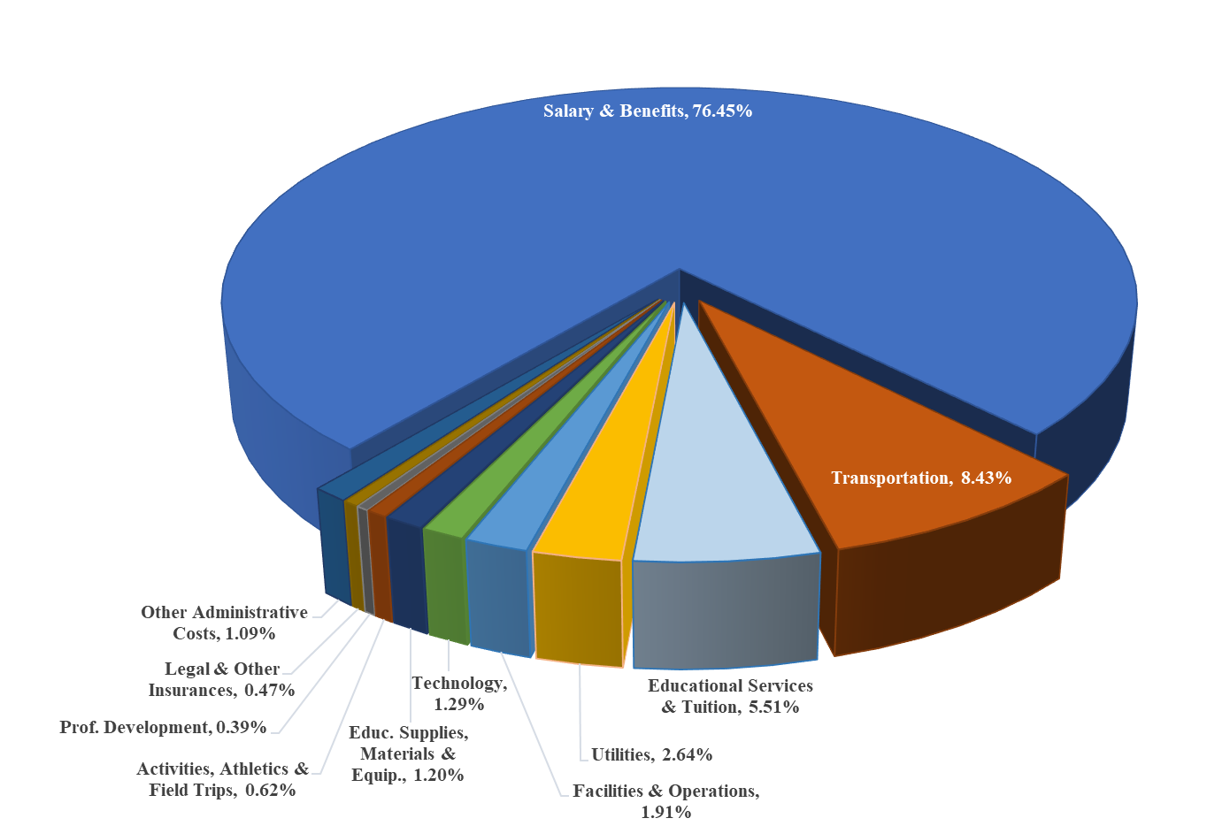

Slide 26
Operating Budget
Expenditures Change
$35,039,758 gross operating budget
$1,517,900 4.53%
$33,014,758 net operating budget
$1,517,900 4.82%

Slide 27
Operating Budget
Difference between Gross Operating and Net Operating due to reduction by Choice & Tuition Revenue
Choice level based on current projections.
Tuition level based on current projections.

Slide 28
CAPITAL BUDGET
FY25
Proposed Budget

Slide 29
Capital Budget
Expenditures Change
$ 533,750 gross operating budget
-$1,183,125 -68.91%

Slide 30
FY25
Stabilization Funding $500,000
Short-Term Interest $ 33,750

Slide 31
FY25
REVENUE

Slide 32
Minimum Local Contribution
Additional Local Contribution
33%
47%
Chapter 70
10%
E&D
2%
Choice & Tuition
Chapter 71
5%
2%
All Other Revenue
1%

Slide 33
Excess & Deficiency
FY23 Certified E&D is $ 792,101
= 2.27% of FY24 total budget
$617,000 used to offset operating budget.
Represents 77.89% of E&D Balance.

Slide 34
FY25
Assessments

Slide 35
Assessments to Member Towns
Three Considerations:
Population Allocation
Minimum Local Contribution
Net Assessment

Slide 36
Assessments to Member Towns
Population Allocation
FY 24 FY 25
Great Barrington 74.4804% 74.2045%
645 653
Stockbridge 13.1640% 12.9545%
114 114
West Stockbridge 12.3557% 12.8409%
107 113

Slide 37
Assessments to Member Towns
Minimum Local Contribution
“ . .. shall annually appropriate [an] amount equal to not less than the sum of the minimum required local contribution . . .”
“The district may choose to spend additional amounts; . . . charged to members according to the district’s required agreement.”
MGL Ch. 70, § 6

Slide 38
Assessments to Member Towns
Minimum Local Contribution*
FY 24 FY 25
Great Barrington $8,090,456 $8,593,682
Stockbridge $1,569,211 $1,693,659
West Stockbridge $1,360,800 $1,499,728
*from Governor’s budgets

Slide 39
Assessments to Member Towns
Net Assessments
FY 24 FY 25
Great Barrington $20,333,733 $21,040,872
Stockbridge $3,733,143 $ 3,866,686
West Stockbridge $3,391,845 $ 3,653,683

Slide 40
Assessments to Member Towns
Change:
Total Assessment 4.02% $ 1,102,519
Change:
Great Barrington 3.48% $ 707,138
Stockbridge 3.58% $ 133,543
W. Stockbridge 7.72% $ 261,838

Slide 41
QUESTIONS
?

