Slide 1

FY24 PROPOSED DRAFT BUDGET
FEBRUARY 2023
Berkshire Hills Regional School District

Slide 2
Mission
To ensure all students are challenged through a wide range of experiences to become engaged, curious learners and problem solvers who effectively communicate, respect diversity, and improve themselves and their community.

Slide 3
Budget Priorities
  Continue to provide high quality education for all students.
  Continue to provide a range of social-emotional supports.
  Ensure equitable access for all students.

Slide 4
Other Considerations
Ongoing regionalization discussions with Southern Berkshire RSD.
Ongoing collaborations with Richmond.
Contract negotiations.

Slide 5
FY24
Proposed Budget

Slide 6

FY 24
BUDGET CHANGES

Slide 7
PERSONNEL
ELEMENTARY SCHOOL
  Reallocate existing resources to meet changing enrollment, as needed.
  Directed Study Supervisor – full year.
  In-depth Professional Development in Literacy.

Slide 8
PERSONNEL
MIDDLE SCHOOL
  New Principal.
  Continued four core teams and specials.
  Continued professional development for SEL.

Slide 9
PERSONNEL
HIGH SCHOOL
  Additional PK-2 certified teacher in Early Childhood program.
  Additional Health teacher.
  Continued review and planning for additional CVTE programming and staffing.

Slide 10
OTHER
  Health & Dental Insurance
    9.0% increase for health total in FY24 ($462,240).
    FY23 increase lower than the 8% set rates due to premium holiday; FY24 compensates for lower increase.
    No premium holiday approved for FY24.
    No change in dental rates.

Slide 11
OTHER
  Health & Dental Insurance (cont.)
    MEDEX rate changes in January of each year; no change for 2023.
  Berkshire County Retirement
    Actual invoice amount to fully fund system, 4.02% ($39,704).

Slide 12
OTHER
  Educational Services & Tuition
    Increase of 5.62% ($105,000).
  Transportation
    Increase of 3.43% ($88,179).
  Athletics & Co-Curriculars
    Increase of 6.14% ($11,050).

Slide 13
OTHER
  Technology
    Increase of 4.37% ($14,500).
  Facilities & Operations
    Slight increase of 1.54% ($11,000).
  Other Administrative Costs
    2.32% increase ($8,500).

Slide 14
OTHER
  Utilities
    Increasing rates results in a 21.27% increase ($146,400).
  Educ. Supplies, Materials & Equip
    Decrease of 14.13% (-$67,215).
  Prof. Development
    Decrease of 16.47% (-$26,800).

Slide 15
OTHER
  Legal & Other insurances
    4.29% decrease (-$7,524)

Slide 16
OPERATING BUDGET
FY24
Proposed Budget

Slide 17
Operating Budget
  Expenditures Change
  $ 33,521,858 gross operating budget
  $1,825,881 5.76%

Slide 18
Summary
CATEGORY CATEGORY % of TOTAL $ CHANGE
CHANGE CHANGE
Salaries 5.87% 56.34% $1,028,772
  Benefits 7.75% 28.15% $ 514,019
  Utilities 21.27% 8.02% $ 146,400

Slide 19
Summary
CATEGORY CATEGORY % of TOTAL $ CHANGE
CHANGE CHANGE
Educ. Services 5.62% 5.75% $ 105,000
& Tuition
  Transportation 3.43% 4.83% $ 88,179
  Technology 4.37% 0.79% $ 14,500

Slide 20
Summary
CATEGORY CATEGORY % of TOTAL $ CHANGE
CHANGE CHANGE
Activities & 6.14% 0.61% $ 11,050
Athletics
  Facilities & 1.54% 0.60% $ 11,000
  Operations
  Other Admin. 2.32% 0.47% $ 8,500

Slide 21
Summary
CATEGORY CATEGORY % of TOTAL $ CHANGE
CHANGE CHANGE
Legal & -4.29% -0.41% $ - 7,520
Other Insurance
  Prof. Develop. -16.47% -1.47% $ -26,800
  Educ. Supplies, -14.13% -3.68% $ -67,215
  Materials & Equip.

Slide 22
BUDGET
by Department

Slide 23
SUMMARY
Elementary School 19.56%
Middle School 17.29%
High School 26.88%
Student Services (+ ELL) 10.70%
74.44%

Slide 24
SUMMARY
Transportation & Food Service 4.64%
District-wide - All Other* 13.08%
School Committee & Administration 5.38%
Facilities & Maintenance 2.46%
* Includes non-public transportation, retiree health insurance, contingency, school choice.

Slide 25
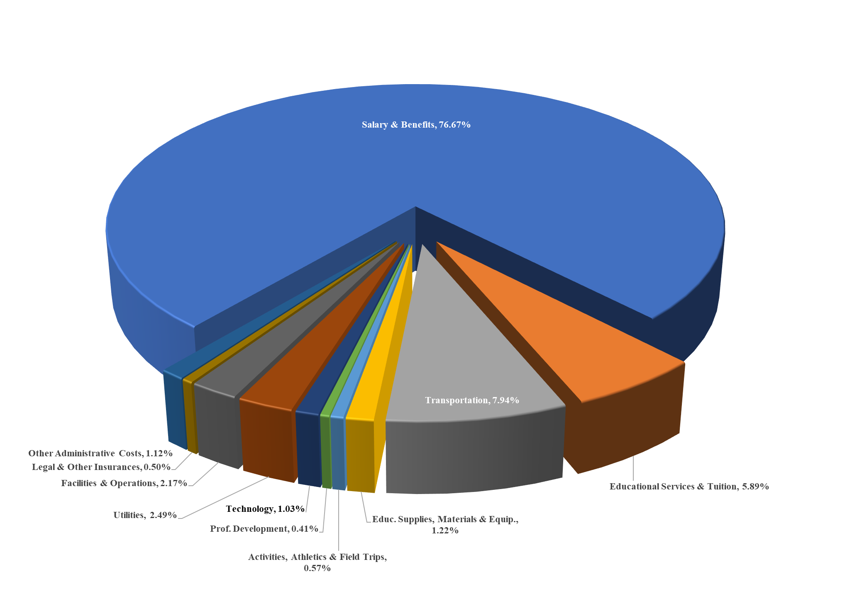

Slide 26
Operating Budget
  Expenditures Change
  $33,521,858 gross operating budget
  $1,825,517 5.76%
  $31,496,858 net operating budget
  $1,825,517 6.15%

Slide 27
Operating Budget
  Difference between Gross Operating and Net Operating due to reduction by Choice & Tuition Revenue
  Choice level based on current projections.
  Tuition level based on current projections.

Slide 28
CAPITAL BUDGET
FY24
Proposed Budget

Slide 29
FY24 – FINAL PAYMENT
Project Principal Interest Total
ES & MS Construction Bond
$1,675,000 $ 41,875 $1,716,875
TOTAL $1,675,000 $ 41,875 $1,716,875

Slide 30
FY24
NET CAPITAL IMPACT on ASSESSMENT
Gross Capital Budget $1,716,875
MSBA & E&D -$1,236,934
TOTAL $ 595,941
(-9.60%)

Slide 31
FY24
REVENUE

Slide 32
Minimum Local Contribution
Additional Local Contribution
30%
47%
Chapter 70
9%
E&D
2%
Choice & Tuition
Chapter 71
6%
2%
All Other Revenue
4%

Slide 33
Excess & Deficiency
FY22 Certified E&D is $1,171,659
    = 3.53% of FY23 total budget
$627,000 used to offset operating budget.
Represents 52.66% of E&D Balance.

Slide 34
FY24
Assessments

Slide 35
Assessments to Member Towns
Three Considerations:
  Population Allocation
  Minimum Local Contribution
  Net Assessment

Slide 36
Assessments to Member Towns
  Population Allocation
  FY 23 FY 24
  Great Barrington 73.4884% 74.4804%
  632 645
  Stockbridge 13.7209% 13.1640%
  118 114
  West Stockbridge 12.7907% 12.3557%
  110 107

Slide 37
Assessments to Member Towns
  Minimum Local Contribution
  “ . .. shall annually appropriate [an] amount equal to not less than the sum of the minimum required local contribution . . .”
  “The district may choose to spend additional amounts; . . . charged to members according to the district’s required agreement.”
  MGL Ch. 70, § 6

Slide 38
Assessments to Member Towns
  Minimum Local Contribution
  FY 23 FY 24*
  Great Barrington $7,696,400 $7,998,869
  Stockbridge $1,491,020 $1,488,233
  West Stockbridge $1,310,375 $1,369,382
  *Projected

Slide 39
Assessments to Member Towns
  Net Assessments
  FY 23 FY 24
  Great Barrington $18,462,204 $19,939,489
  Stockbridge $3,501,086 $3,598,672
  West Stockbridge $3,184,170 $3,350,179

Slide 40
Assessments to Member Towns
Change:
Total Assessment 6.50% $ 1,677,631
Change:
Great Barrington 7.58% $1,436,716
Stockbridge 2.38% $ 85,589
W. Stockbridge 4.75% $ 155,326

Slide 41
QUESTIONS
?

