Slide 1
Berkshire Hills Regional
School District
FY 22 Proposed Budget
February 11, 2021

Slide 2
Mission
To ensure all students are challenged through a wide range of experiences to become engaged, curious learners and problem solvers who effectively communicate, respect diversity, and improve themselves and their community.

Slide 3
Budget Priorities
  Reintegrate students into full-time face-to-face learning with a wide range of socio-emotional supports.
  Address potential impacts from pandemic.
  Ensure equitable access for all students.

Slide 4
Other Considerations
  Ongoing regionalization discussions with Southern Berkshire RSD.
  Ongoing collaborations with Richmond for shared services.

Slide 5
FY22
PROPOSED BUDGET

Slide 6
FY22
BUDGET CHANGES

Slide 7
Personnel
  Elementary School
    Two plans for fall opening based on existing pandemic conditions.
    Reallocating existing resources to meet changing enrollment, as needed.

Slide 8
Personnel
  Middle School
    Planning for opening based on existing conditions in the fall.
    Four core teams and specials.

Slide 9
Personnel
  High School
    Planning based on existing conditions in the fall.
    Maintain CTE position.
    Continue work on academic redesign for school day and year.

Slide 10
Other
  Berkshire County Retirement
    Actual invoice amount to fully fund system.
  Worker’s Compensation
    Actual FY21 plus 10% = 4.58% increase.
  Other insurances, plus 10% = 0% increase.

Slide 11
Other
  Health & Dental Insurance
    No increase for Health in FY22.
    No increase for Dental in FY22.
    MEDEX rate changes in January of each year.

Slide 12
Other
  Transportation
    CPI Increase of 1.70%.
    Increase to special education to actuals plus 1.70%
  Technology
    Instructional software and hardware.

Slide 13
Other
  Supplies/Texts/Materials
    Increased particularly in Math to align with state curriculum.
    Decreases in other lines where able.

Slide 14
CAPITAL
  Repayment of short-term borrowing for ES chiller repairs.
  HS restructuring of common spaces to provide additional shared learning space.

Slide 15
BUDGET by
Department

Slide 16
Considerations
Benefits Allocated Proportionally.
Full costs of schools, including facilities/grounds.

Slide 17
Summary
Elementary School 19.09%
Middle School 18.01%
High School 26.20%
Student Services (+ ELL) 10.03%
73.33%

Slide 18
Summary
District-Wide – All Other * 13.78%
School Committee & Administration 7.56%
Facilities & Maintenance 2.38%
District-Wide – Tech. & Food Service 2.96%
* Includes non-public transportation and all contingency.

Slide 19
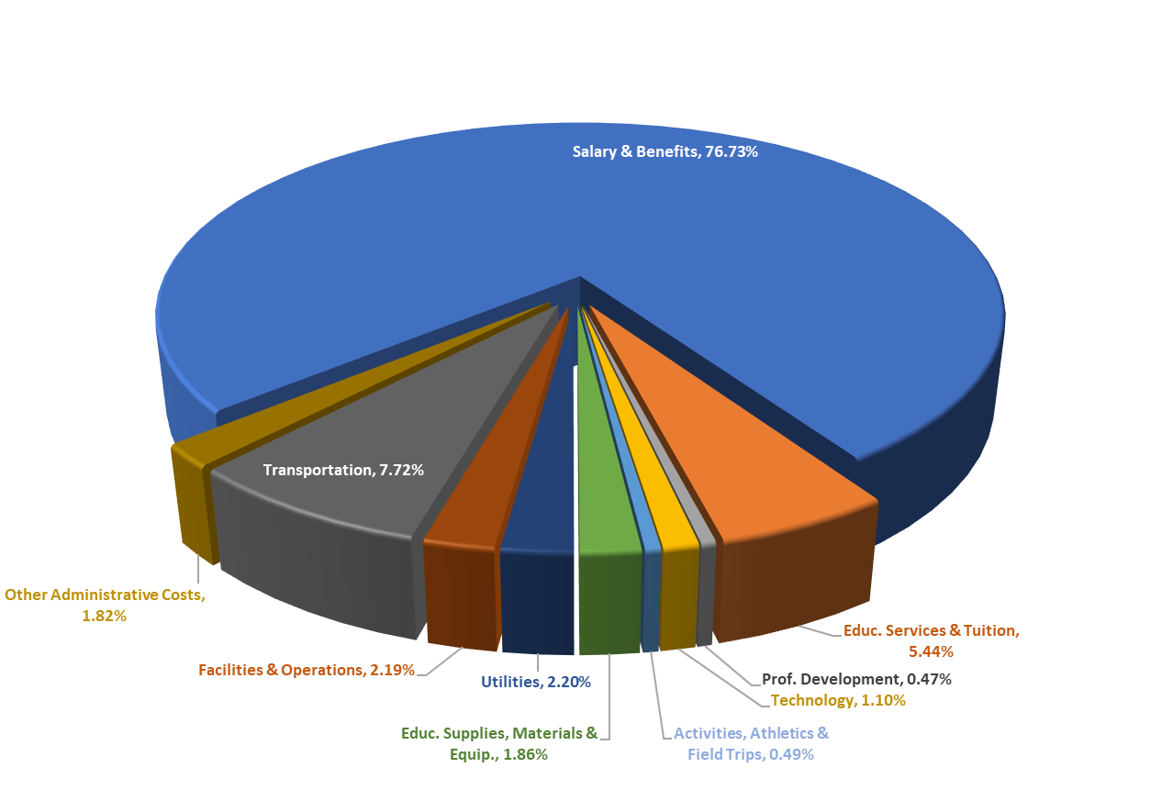
FY 22 Proposed Budget
District by Function

Slide 20
Operating Budget
  Expenditures Change
  $30,284,460 gross budget
  $ 936,399 3.19%
  $28,304,460 net operating budget
  $ 956,399 3.50%

Slide 21
Operating Budget
  Difference between Gross Operating and Net Operating due to reduction by Choice & Tuition Revenue
  Choice increased based on current projections.
  Tuition decreased based on current projections.

Slide 22
FY22
CAPITAL BUDGET

Slide 23
FY 22
Project Principal Interest Total
ES & MS Construction Bond
$1,590,000 $ 206,250 $1,796,250
Additional
Repayment of FY21 Short-Term Borrowing $ 80,000
High School Common Spaces $ 80,000
TOTAL Capital $1,956,250

Slide 24
FY22
REVENUE

Slide 25
Revenue
Chapter 70
$ 2,961,498 0%
Chapter 71
$ 800,000 3.1%
School Choice
$ 1,275,000 0.2%
Tuition
$ 705,000 (6.0%)
MSBA
$ 1,120,934 0%

Slide 26
Revenue
Other
Medicaid Reimbursement
Interest Income
Miscellaneous Income
All Other $117,000 (2.50%)

Slide 27
Revenue
Excess & Deficiency
FY 22 Use
  $352,000 – for Operating Budget
  $160,000 – for additional capital
  Represents 48% of E&D balance

Slide 28
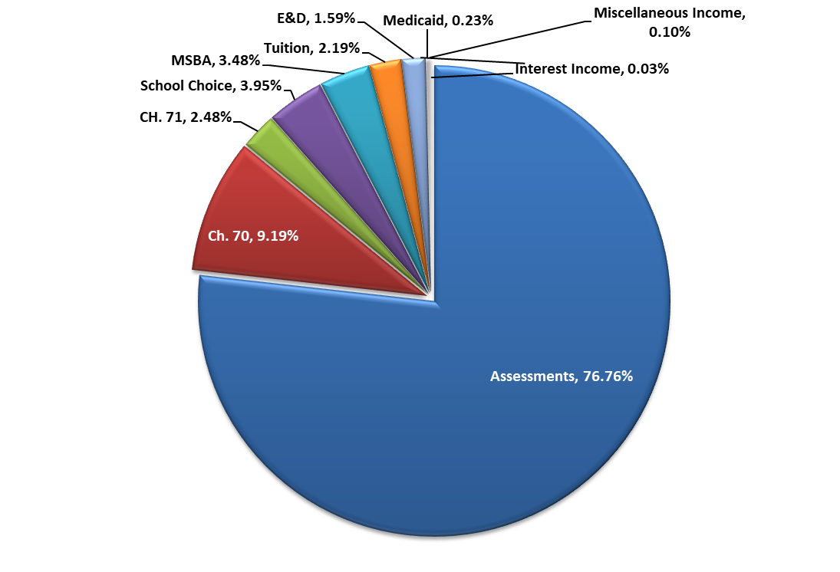
Revenue Sources

Slide 29
FY22
ASSESSMENTS

Slide 30
Assessments to Member Towns
Three Considerations:
  Population Allocation
  Minimum Local Contribution
  Net Assessment

Slide 31
Assessments to Member Towns
  Population Allocation
  FY 21 FY 22
  Great Barrington 74.2187% 74.5704%
  Stockbridge 12.3884% 12.7148%
  West Stockbridge 13.3929% 12.7148 %

Slide 32
Assessments to Member Towns
  Minimum Local Contribution
  “ . .. shall annually appropriate [an] amount equal to not less than the sum of the minimum required local contribution . . .”
  “The district may choose to spend additional amounts; . . . charged to members according to the district’s required agreement.”
  MGL Ch. 70, § 6

Slide 33
Assessments to Member Towns
  Minimum Local Contribution
  FY 21* FY 22
  Great Barrington $7,264,901 $7,300,930
  Stockbridge $1,220,907 $1,260,218
  West Stockbridge $1,402,529 $1,260,218
  *FY21 budgeted amount

Slide 34
Assessments to Member Towns
  Net Assessment
  FY 21 FY 22
  Great Barrington $17,567,330 $18,432,734
  Stockbridge $ 2,940,563 $ 3,158,272
  West Stockbridge $ 3,261,621 $ 3,158,272

Slide 35
Assessments to Member Towns
Change:
Total Assessment 4.12% $ 979,764
Change:
Great Barrington 4.93% $ 865,404
Stockbridge 7.40% $ 217,709
W. Stockbridge -3.17% ($ 103,349)

Slide 36
FY21 Grants
  Dept. of Justice $818,546
  Special Education: IDEA $437,734
  21st Century CCLC - DW $400,740
  Mass IDEAS $202,025
  Title I $189,735
  Rural Health $ 85,000
  GB Fund $ 80,000

Slide 37
Grants
  BUW – Project Connection $ 40,000
  Title II $ 35,600
  Special Education: Early Child. $ 14,740
  Title IVA $ 12,535
  BUW – Greenagers $ 12,500
  Perkins (CVTE) $ 14,060
  BCREB $ 3,000

Slide 38
Grants
  BTFE $ 2,655
  Bridging Divides* $ 2,500
  COVID Recovery Grants:
  CvRF $ 220,050
  ESSER 1 $ 141,157
  Remote Technology $ 29,336
  Total to Date: $2,741,913

Slide 39
Grants
  Additional Grants to be Awarded
  ESSER 2 $ 559,315
  State Coronavirus Prevention $ 56,625
  Rural Sparsity Grant UNK

Slide 40
QUESTIONS?

