Slide 1
Berkshire Hills Regional
School District
FY 20 Proposed Budget
February 14, 2019

Slide 2
Mission
To ensure all students are challenged through a wide range of experiences to become engaged, curious learners and problem solvers who effectively communicate, respect diversity, and improve themselves and their community.

Slide 3
Budget Priorities
Maintain levels of funding that will provide high quality education for all our students.
Expand opportunities for student success.
Ensure equitable access for all students.

Slide 4
FY19 Initiatives Leading to FY20 Impacts

Slide 5
Learning & Teaching
New leadership model implemented:
Instructional Leaders
Team Coordinators
Refining for FY20

Slide 6
Learning & Teaching
Working with Great School Partnership
Training to support school “redesign” to improve outcomes for all students and better prepare them for career and college.

Slide 7
Learning & Teaching
Professional Development with Teachers Development Group.
Teacher development to increase all students’ math understanding and achievement.

Slide 8
Learning & Teaching
Career Technical Education
Creating new pathways and rethinking career and technical education at the high school.

Slide 9
Learning & Teaching
K – 12 Curriculum Alignment.
Performance Matters Data Analysis Tool.

Slide 10
FY20 PROPOSED BUDGET

Slide 11
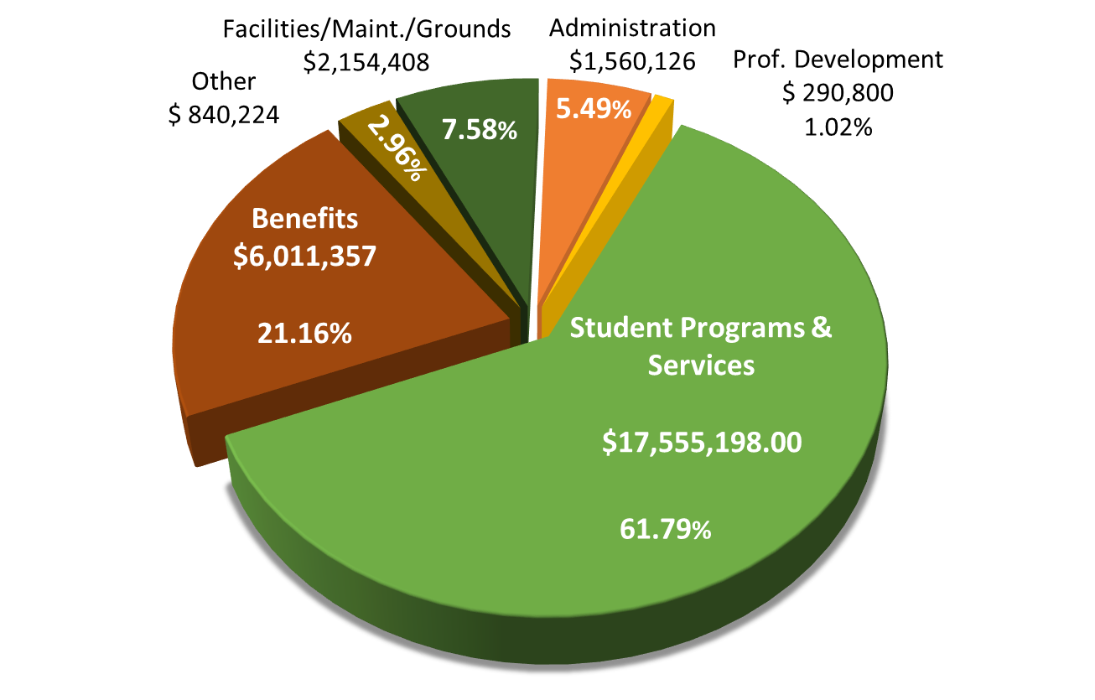
FY 20 Proposed Budget
District by Categories

Slide 12
FY20 BUDGET CHANGES

Slide 13
Personnel
Elementary School
Reallocating existing resources to meet changing enrollment, as needed.

Slide 14
Personnel
Middle School
Retirement not replaced; back filled by moving grant funded position into operating budget.
Free up Title I funds.

Slide 15
Personnel
High School
Addition of a clinician for the Bridge to Resilient Youth (BRTY) Program.
A progression of the programs at the ES & MS.
Reassignment of one paraprofessional.
Maintain CVTE Director position.

Slide 16
Personnel
Districtwide
School Psychologist Intern.

Slide 17
Other
Berkshire County Retirement
Actual invoice amount to fully fund system.
Worker’s Compensation
Actual FY19 plus 10%.
Other insurance plus 10%.

Slide 18
Other
Health & Dental Insurance
No increase for FY20.

Slide 19
Other
Transportation
CPI Increase of 2.4%.
Increase to special education to actuals plus 2.4%.
Technology
Increase in instructional software and hardware.
Increase in Districtwide software.
Special education technology accounts moved.

Slide 20
Other
Supplies/Texts/Materials
Increased particularly in core subjects of ELA, Math and science to align with state core curriculum.
Decreases in other lines where able.
Equipment & Equipment Maintenance
Moved special education costs to more appropriately account for costs.

Slide 21
CAPITAL
Tennis Court Repairs
Telephone systems at ES & MS replacement.
One Truck replacement.
Wheelchair accessible van.

Slide 22
CAPITAL
Band Uniform replacement
Stabilization Fund investment
All capital listed above to be funded by E&D.

Slide 23
BUDGET by Department

Slide 24
Considerations
Benefits Allocated Proportionally.
Full costs of schools, including facilities/grounds.

Slide 25
Summary
Elementary School 20.41%
Middle School 18.08%
High School 25.97%
Student Services (+ ELL) 9.60%
74.06%

Slide 26
Summary
District-Wide – All Other * 13.72%
School Committee & Administration 7.56%
Facilities & Maintenance 2.33%
District-Wide – Tech. & Food Service 2.45%
* Includes non-public transportation and all contingency.

Slide 27
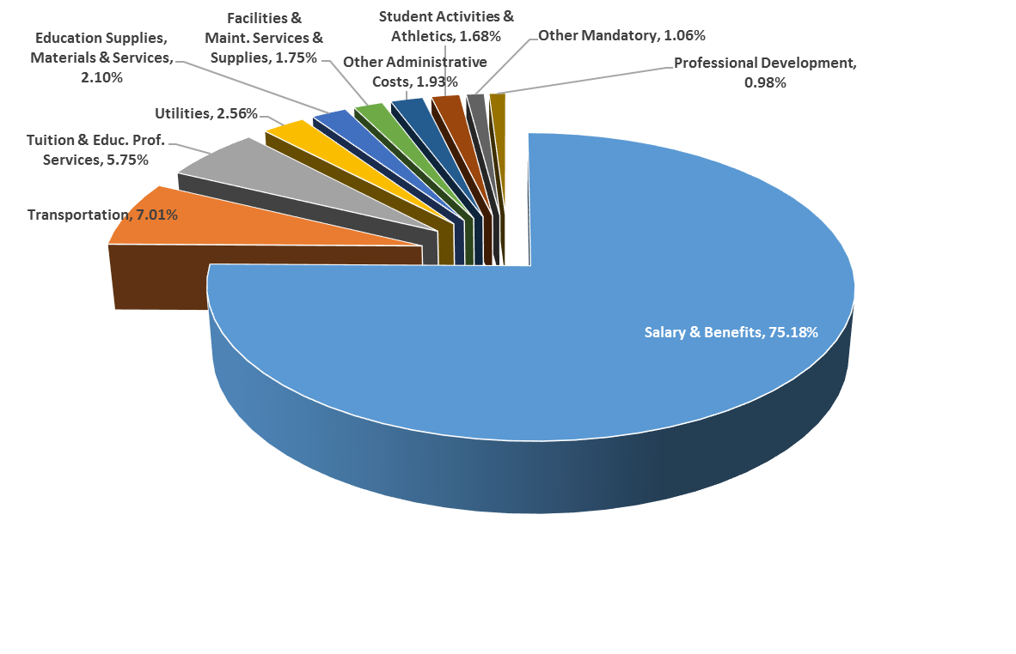
FY 20 Proposed Budget
District by Function

Slide 28
Operating Budget
Expenditures Change
$28,412,113 gross budget
$1,155,996 4.24%
$26,212,113 net operating budget
$1,058,417 4.21%

Slide 29
Operating Budget
Difference between Gross Operating and Net Operating due to reduction by Choice & Tuition Revenue
Choice up $125,000 after use of reserve funds.
Tuition down by $27,421 after use of 150,000 in reserves.

Slide 30
FY20 CAPITAL BUDGET

Slide 31
FY 20
Project Principal Interest Total
ES & MS Construction Bond
$1,450,000 $ 358,000 $1,808,000
ST Borrowing $ 100,000 $ 25,000 $ 125,000
Capital Purchases/Repairs $ 0 $ 0 $ 185,000
Stabilization Fund $ 0 $ 0 $ 100,000
TOTAL $1,550,000 $ 383,000 $2,218,000

Slide 32
FY20 REVENUE

Slide 33
Revenue
Chapter 70
$ 2,923,288 1.07%
Chapter 71
$ 725,000* 3.57%
School Choice
$ 1,250,000 11.11%
Tuition
$ 950,000* (2.81%)
MSBA
$ 1,120,934 0%
*Includes use of Fund Balance

Slide 34
Revenue
Other
Medicaid Reimbursement
Interest Income
Miscellaneous Income
All Other $117,500 0.00%

Slide 35
Revenue
Excess & Deficiency
FY 20 Use
$555,018 – for Operating Budget
$285,000 – for Capital Budget
Represents 61.61% of E&D balance

Slide 36
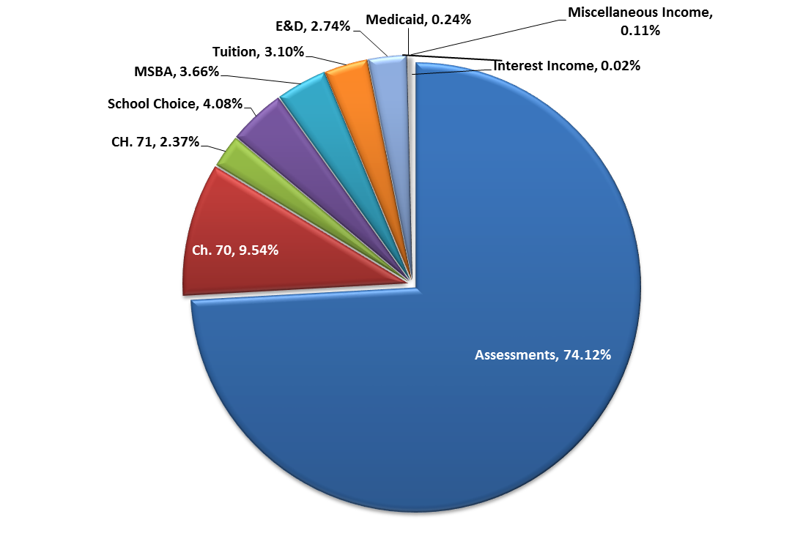
Revenue Sources

Slide 37
FY19 ASSESSMENTS

Slide 38
Assessments to Member Towns
Three Considerations:
Population Allocation
Minimum Local Contribution
Net Assessment

Slide 39
Assessments to Member Towns
Population Allocation
FY 19 FY 20
Great Barrington 73.0426% 73.5327%
Stockbridge 13.6101% 12.8461%
West Stockbridge 13.3473% 13.6212%

Slide 40
Assessments to Member Towns
Minimum Local Contribution
“ . .. shall annually appropriate [an] amount equal to not less than the sum of the minimum required local contribution . . .”
“The district may choose to spend additional amounts; . . . charged to members according to the district’s required agreement.”
MGL Ch. 70, § 6

Slide 41
Assessments to Member Towns
Minimum Local Contribution
FY 19 FY 20
Great Barrington $7,192,554 $7,258,074
Stockbridge $1,256,506 $1,220,984
West Stockbridge $1,222,146 $1,342,853

Slide 42
Assessments to Member Towns
Net Assessment
FY 19 FY 20
Great Barrington $16,155,297 $16,730,161
Stockbridge $ 2,926,543 $ 2,875,749
West Stockbridge $ 2,859,936 $ 3,097,463

Slide 43
Assessments to Member Towns
Change:
Total Assessment 3.47% $ 761,597
Change:
Great Barrington 3.56% $ 574,863
Stockbridge (1.74%) ($ 50,793)
W. Stockbridge 8.31% $ 237,527

Slide 44
Grants
Special Education: IDEA $436,918
Title I $194,181
21st Century CCLC $224,400
MA Ideas Planning Grant $127,000
RADAR (2 year total) $50,000
Title II $35,706
Title IVA $15,714
Special Education: Early Child. $14,421

Slide 45
Grants
21st Century: Special Education $ 14,250
Service Learning: PD $ 16,421
Parent-Child – Early Education $ 27,500
After-School Service Learning $ 15,000
Perkins (CVTE) $ 12,984
Safe & Supportive Schools $ 10,000
MS – Turnaround Support $ 10,000
Rural School Aid $ 21,275

Slide 46
Grants
Innovative Pathways* $ 10,000
STARS $ 8,600
BTFE $ 2,331
Total to Date: $1,246,701
*Includes opportunity for significant additional grant funds

Slide 47
Grants
Additionally:
FY20 & FY21
Already received grants to begin July 1, 2019 for a total of $90,000 for Project Lead The Way.
Computer Science Program at the high school
Engineering Program at the high school
Gateway Program at the middle school

Slide 48
QUESTIONS?

